Slide 1
Big Mountain Resort Project
Summary and methodology

Slide 2
Problem Identification

Slide 3
Big Mountain Resort offers spectacular views of Glacier National Park and Flathead National Forest, with access to 105 trails. Big Mountain Resort has recently installed an additional chair which increased their operational costs by $1,540,000 this season. So Big Mountain resort has to come up with new pricing strategy to overcome this additional operational costs.
Aims to build a predictive model for ticket price based on a number of facilities, or properties, boasted by resorts (at the resorts). This model will be used to provide guidance for Big Mountain's pricing and future facility investment plans.

Slide 4
Recommendation and key findings
If the resort would like to increase the ticket price further , it is recommended that management focus on increasing the snowmaking average and the number of runs, in that order. Price was predicted for increases in each characteristic while holding other metrics constant.
If the prices of the tickets increases then we can manage operational cost for chair lift.

Slide 5
Modelling Results and Analysis

Slide 6
The recommendations were discovered using two multiple linear regression models. The first model was constructed by simplifying the dataset from what was provided, removing all traits inherent to the mountain. This allowed focus on the traits that management can change and predict which would have the most significant effect upon the pricing of adult weekend tickets. The second model we used random forest, considered both alterable traits that management can improve upon, and inherent features of each mountain, such as state, elevation drop, and snowfall. This model is used to predict the price as accurately as possible.

Slide 7
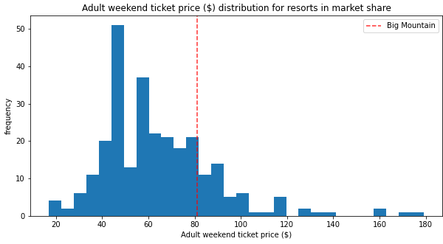
The predicted price of adult weekend tickets using the resort’s current features is $81.77, which is very close to the actual price of adult weekend tickets ($81.00). Rounding up to the nearest whole dollar, the resort can immediately adjust their adult weekend ticket price to $82.00.

Slide 8
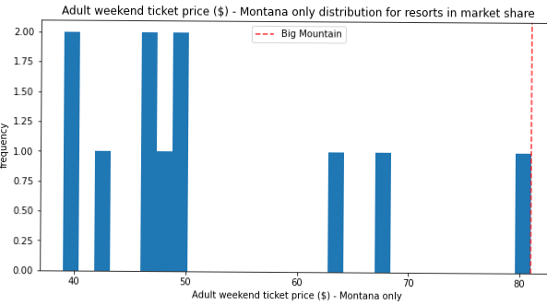
Adult weekend price market share in montana state only.

Slide 9
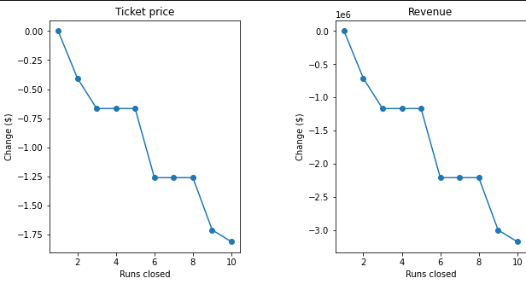
The model says closing one run makes no difference. Closing 2 and 3 successively reduces support for ticket price and so revenue. If Big Mountain closes down 3 runs, it seems they may as well close down 4 or 5 as there's no further loss in ticket price. Increasing the closures down to 6 or more leads to a large drop.

Slide 10
Summary
The price sensitivity of consumers was not factored into these models. We still do not know how price increases will affect the number of resort visitors, and it is a major concern considering Whitefish Mountain Resort is priced higher than any other resort in Montana. Price drops could lead to higher revenue due to increased number of visitors. One possible solution to answer this question is to find historical versions of the same dataset we used to model, and couple it with a dataset tracking the number of visitors. That would allow us to see how price changes over the years affect number of resort visitors.
And conclusion

